Slide 1
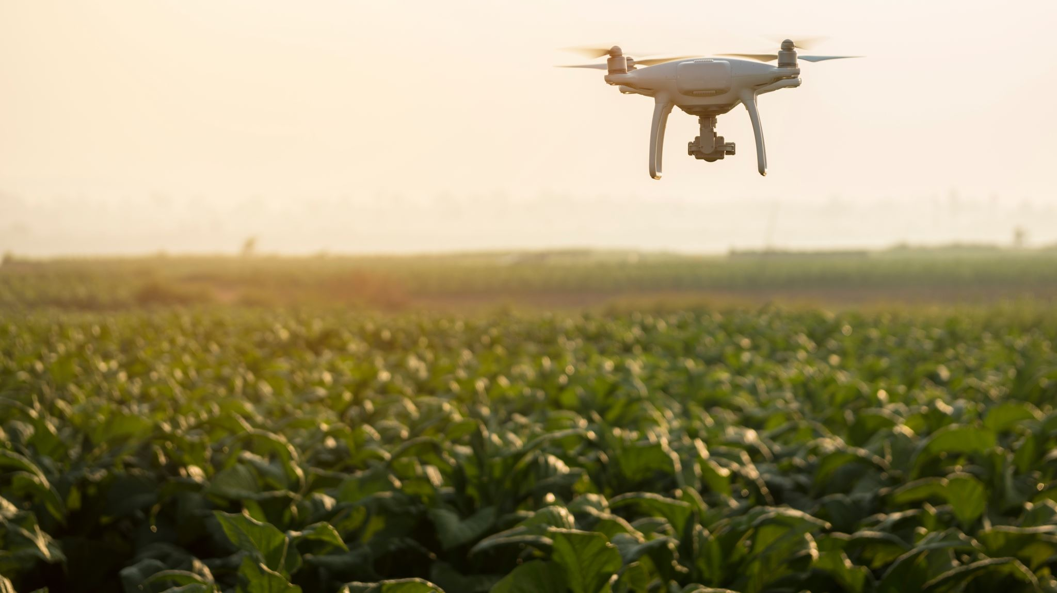
Intelligent Swarm-Based Autonomous Drone Fleet
For Disaster Area Mapping

Slide 2
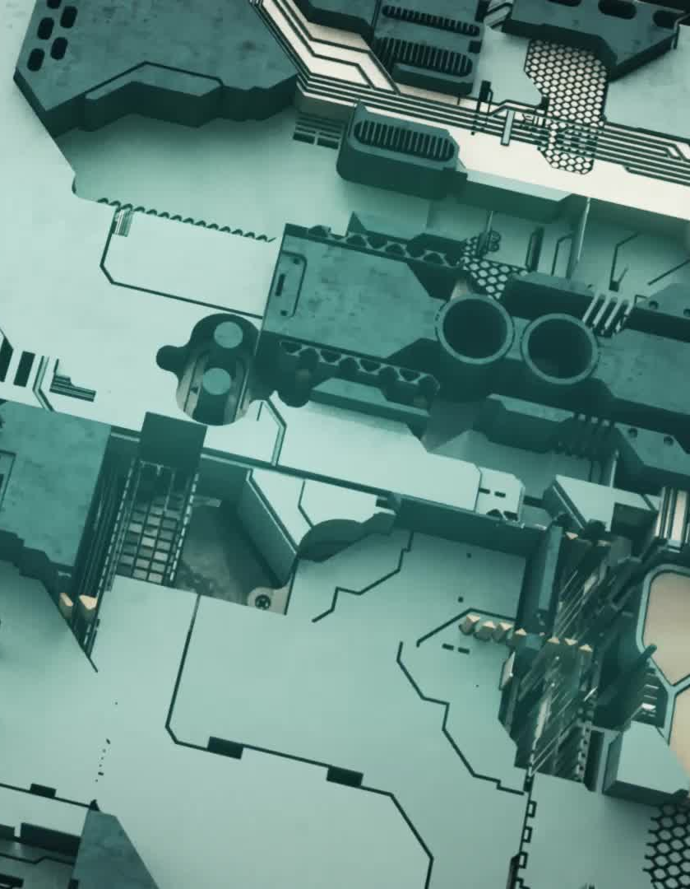
Project Overview
This project uses swarm intelligence to create a fleet of drones for disaster mapping. The goal is to improve response times and safety by automating the process.

Slide 3
Key Technologies
- Swarm Optimization Algorithm PSO
- IoT Components and Communication Modules
- Autonomous Multi-Agent Systems
- Cloud Data Storage and Visualization

Slide 4
Swarm Optimization Algorithms
Swarm intelligence mimics natural behaviors, allowing drones to collaboratively cover an area.
Algorithms include:
- Particle Swarm Optimization (PSO)

Slide 5
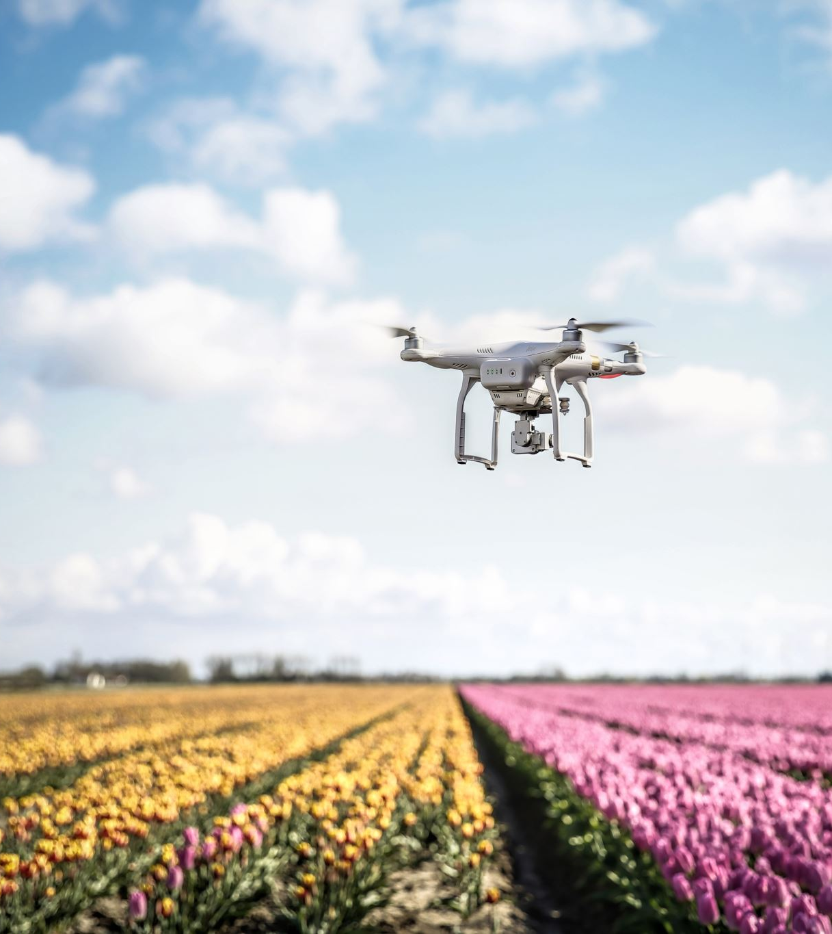
Autonomous Decision-Making
Each drone operates independently, sharing data to adjust paths and avoid obstacles dynamically.

Slide 6
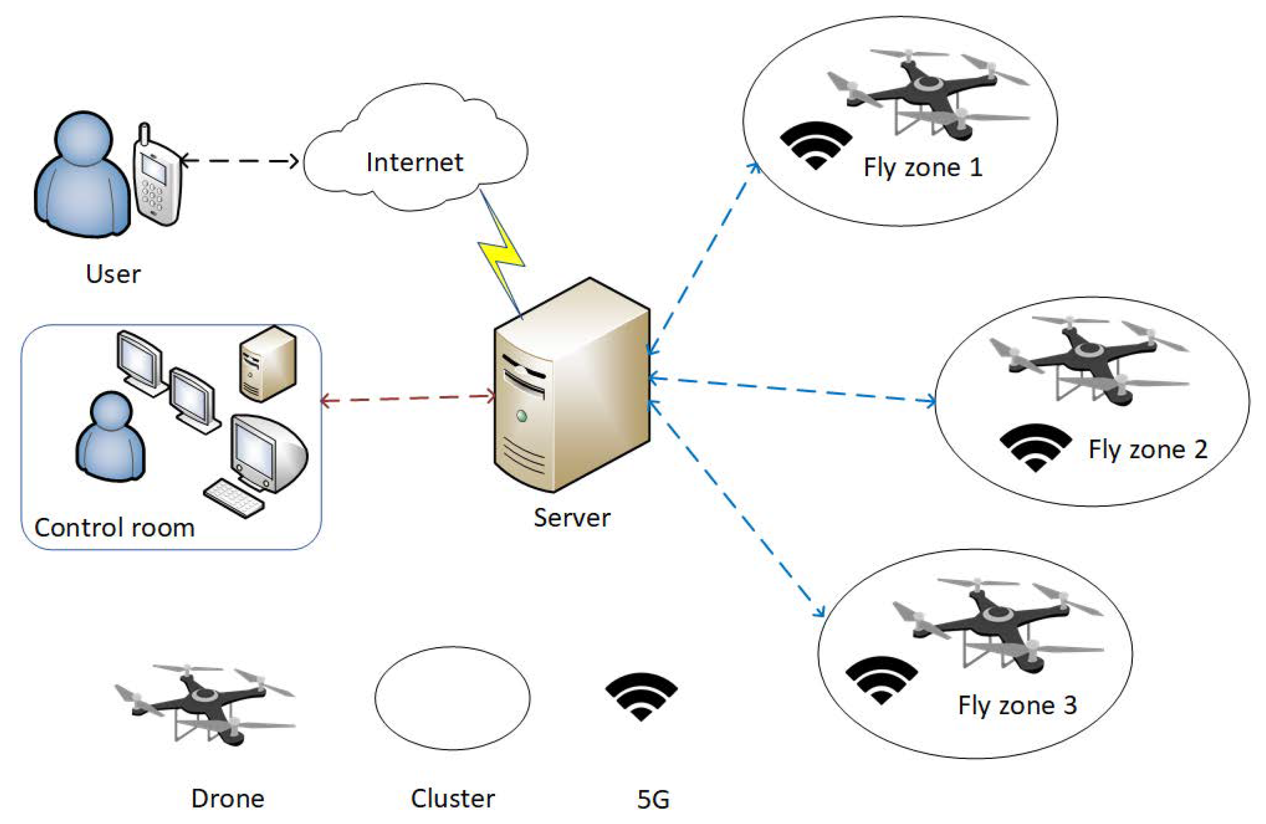

Slide 7
Implementation
Implementation of the PSO algorithm on each drone’s microcontroller, enabling each to calculate its path based on the information received from other drones.
Set up GPS for real-time positioning, cameras for image capture, and communication modules for inter-drone data sharing
Store and process incoming data to generate a live map, update area coverage, and adjust drone routes dynamically as new data is received
Develop a dashboard to display live data from each drone, showing current coverage, the overall mapped area, and the progress in real time.

Slide 8
Challenges & Solutions
- Collision Avoidance: Achieved through inter-drone communication
- Battery Optimization: Swarm algorithms minimize redundant travel
- Adaptability: Drones adjust paths based on real-time data

Slide 9
Tools
- Drones: Autonomous drones equipped with microcontrollers (e.g., ESP32, Raspberry Pi) for onboard processing.
GPS Modules: For real-time positioning and navigation.
Cameras: Standard or thermal imaging cameras to capture data and identify heat signatures for locating survivors.
Communication Modules: LoRa or WiFi modules to enable inter-drone communication and data transmission to the central server.

Slide 10
Conclusion
This project demonstrates the power of swarm intelligence in disaster management by automating the mapping process. Autonomous drones can quickly cover large areas, providing critical data with minimal human intervention and significantly enhancing response times. The swarm-based approach not only optimizes coverage but also enables safer and more accurate exploration of high-risk zones, offering a highly effective solution for real-time disaster mapping.

Slide 11
Thank You!

